Slide 1
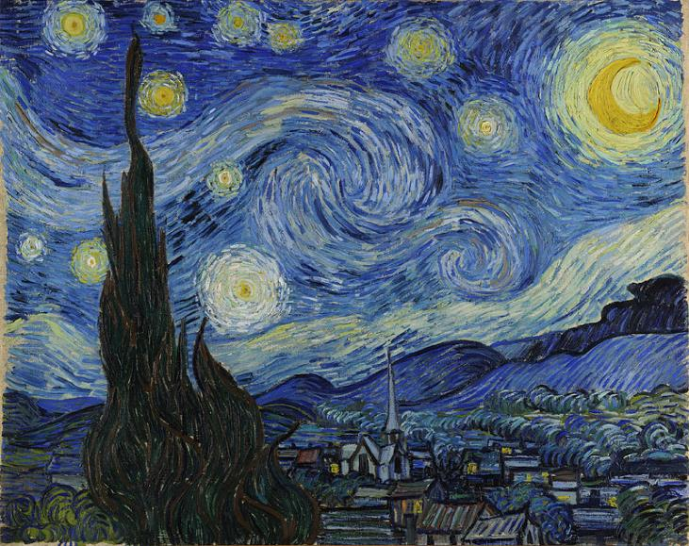
Vincent van Gogh (1853 – 1890)

Slide 2
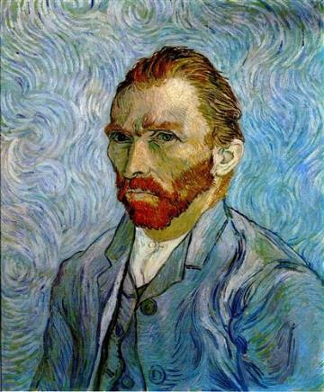
Vincent van Gogh (1853 – 1890)
Vincent van Gogh was a post-impressionist painter from the Netherlands. He was inspired by the colors and the thick brushstrokes he saw in Impressionist paintings. Some of his compositions were also inspired by Japanese printmakers like Hiroshige and Hokusai.
Vincent van Gogh created hundreds of paintings during his lifetime. Many of his paintings are known for their expressive brushstrokes and their sense of movement. His work has influenced many other artists, most notably the Expressionist artists. Although he had difficulties selling his paintings during his lifetime, today his paintings are among the most expensive paintings in the world.

Slide 3
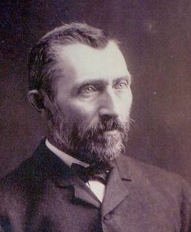
Vincent van Gogh (1853 – 1890)
Vincent van Gogh was born in 1853 in the Netherlands. He was one of six children in his family. He was very close to his younger brother, Theo. Vincent’s uncle helped him get his first job, as an art dealer. Vincent was successful as an art dealer and that was a happy time in his life. He later decided to pursue his desire to become a pastor. He began to study theology, but unfortunately did not pass the entrance exam. Instead, he preached as a missionary in small villages.

Slide 4
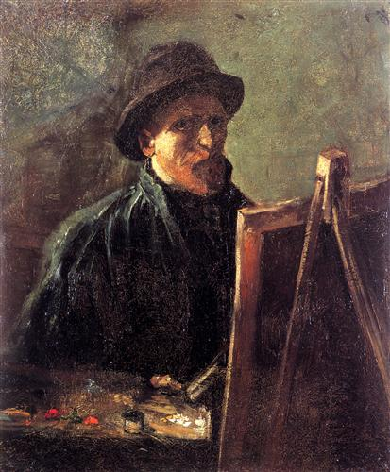
Vincent van Gogh (1853 – 1890)
Throughout his life, Vincent loved to draw and paint. When other career options were not working out, his brother Theo convinced Vincent to attend art school and seriously consider painting as a profession. However, Vincent never had much luck selling his artwork, and he lived in poverty for much of his life.

Slide 5
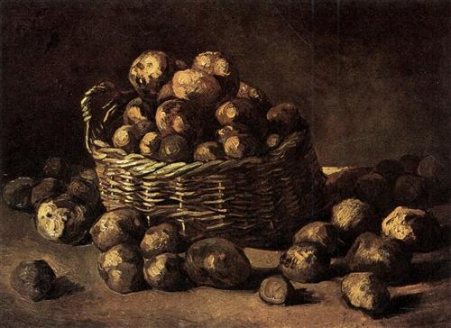
Basket of Potatoes,
1885

Slide 6
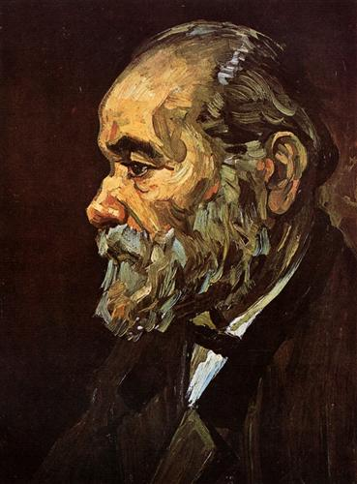
Portrait of an Old Man with Beard
1885

Slide 7
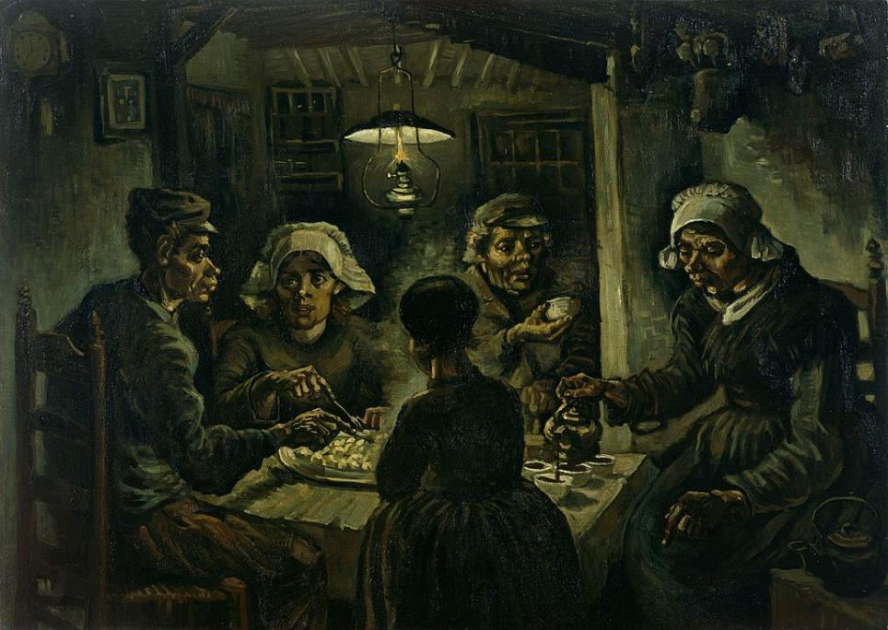
The Potato Eaters, 1885

Slide 8
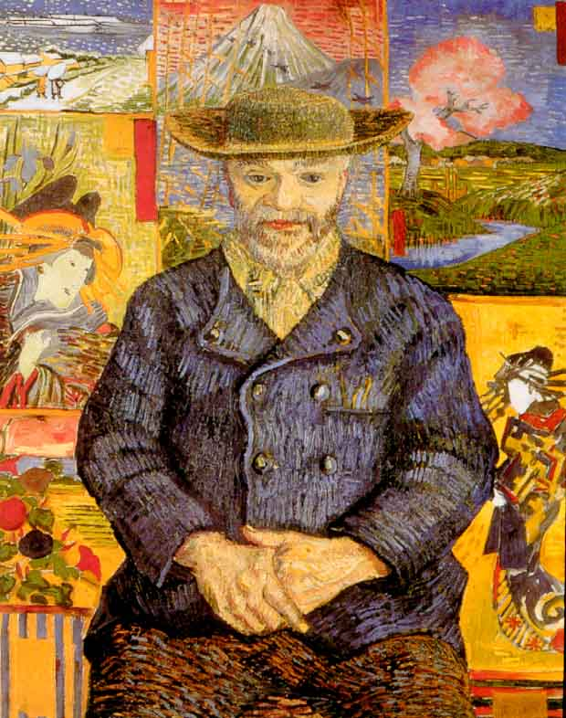
In 1886, Vincent moved to Paris with his brother Theo, where Theo had an art gallery. In Paris, Vincent’s work became brighter and more colorful than the darker, more neutral-colored paintings he had been making in the Netherlands. Vincent collected ukiyo-e woodblock prints, such as those by Hiroshige and Hokusai. He was also exposed to much Impressionist work in Paris, as Theo had a collection of Impressionism paintings in his gallery. Vincent befriended many other important artists who were living in Paris at the time.
Portrait of Père Tanguy, 1887

Slide 9
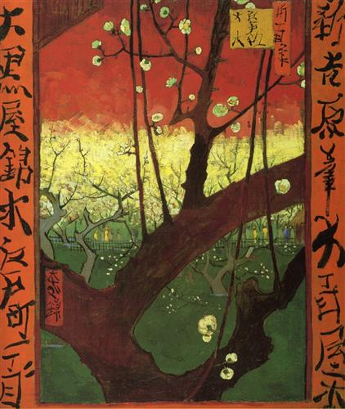
Plum Tree (after Hiroshige)
1887

Slide 10
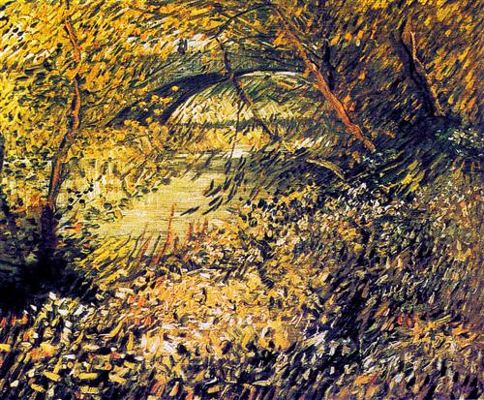
The Impressionism movement was a major influence on van Gogh’s later work. He mimicked the individual brushstrokes the Impressionists were known for and infused them with an even greater sense of movement.
Banks of the Seine in the spring,
1887

Slide 11
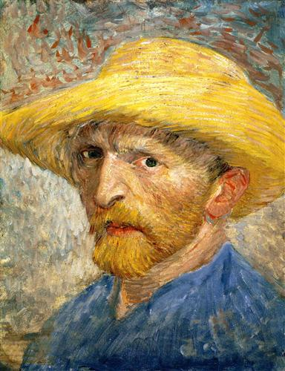
Self Portrait
1887

Slide 12
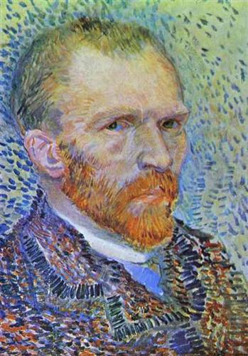
Self-portrait
1887

Slide 13
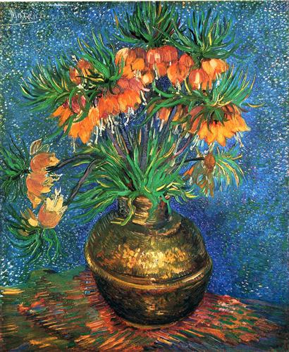
Fritillaries in a Copper Vase
1887

Slide 14
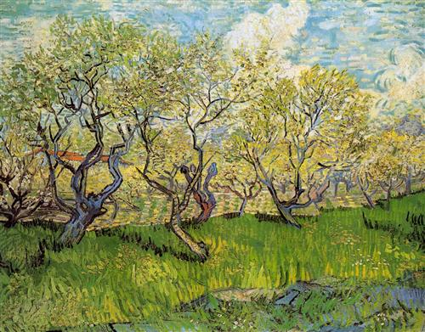
Orchard in Blossom
1888

Slide 15
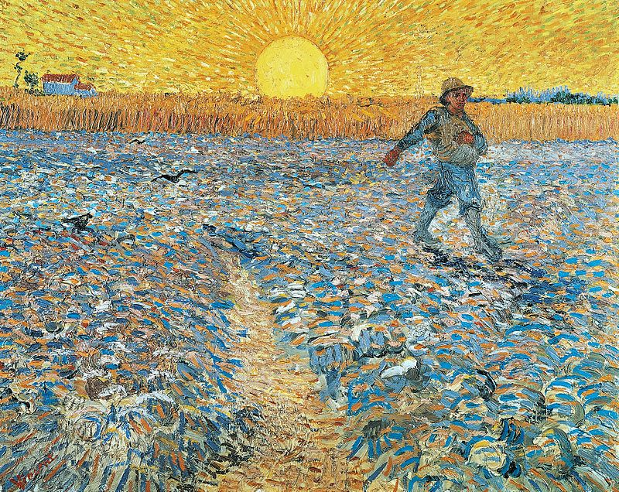
The Sower, 1888

Slide 16
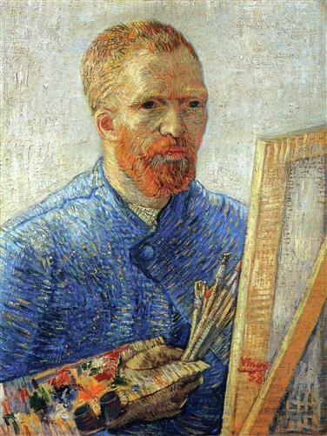
Self Portrait as an Artist
1888

Slide 17
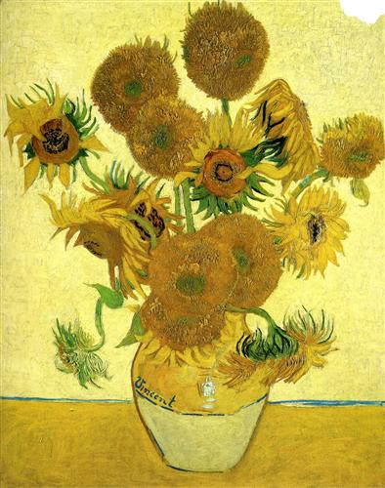
Flowers, especially sunflowers and lilacs, were a favorite subject of van Gogh’s. He tried to capture each sunflower at a different angle.
Still Life - Vase with Fifteen Sunflowers
1888

Slide 18
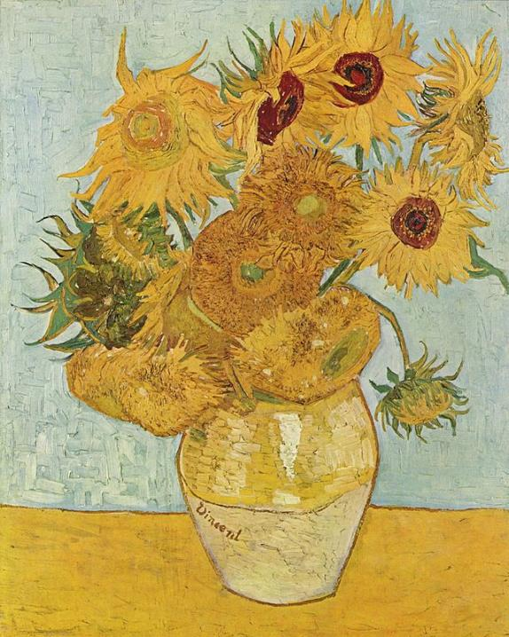
Still Life: Vase with Twelve Sunflowers,
August 1888

Slide 19
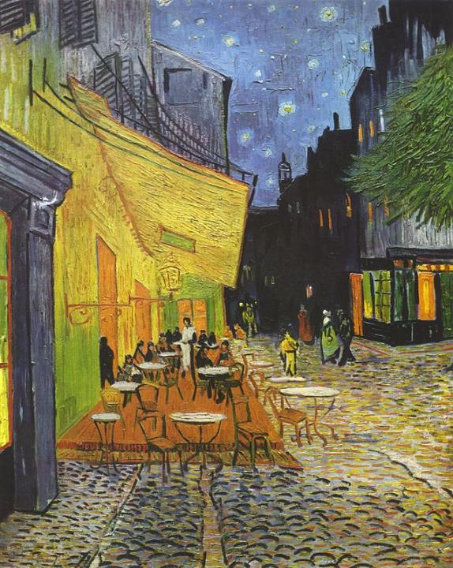
The Café Terrace on the Place du Forum, Arles, at Night, September 1888

Slide 20
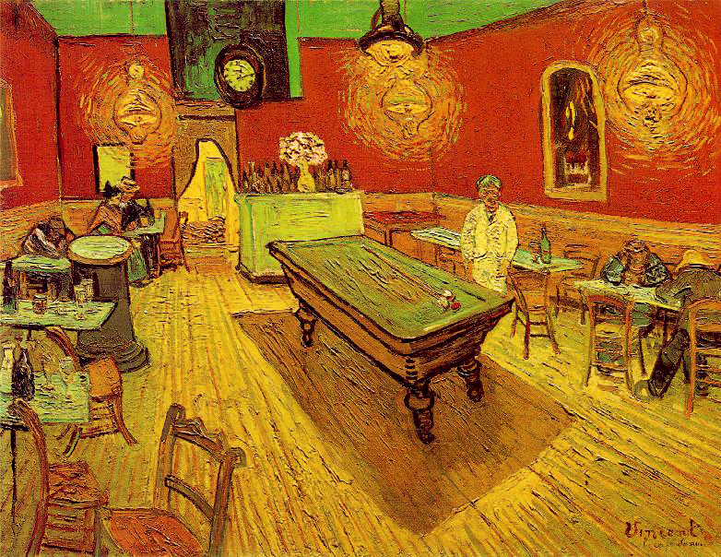
The Night Café, 1888

Slide 21
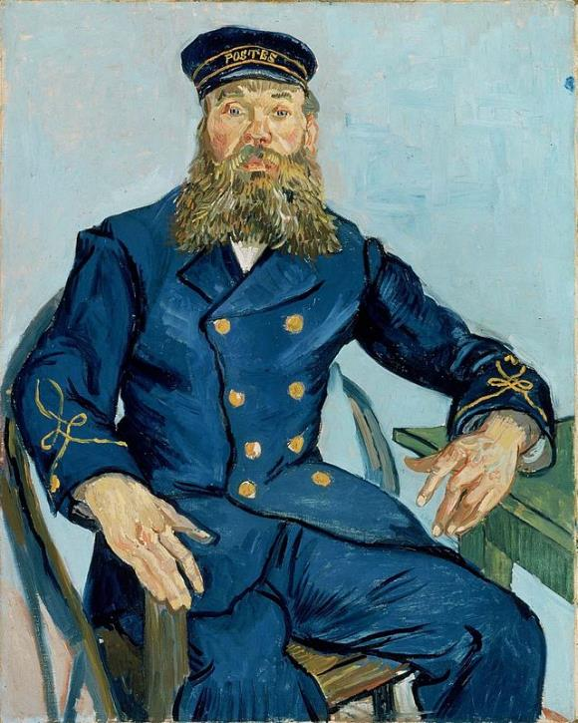
Joseph Roulin (The Postman), 1888

Slide 22
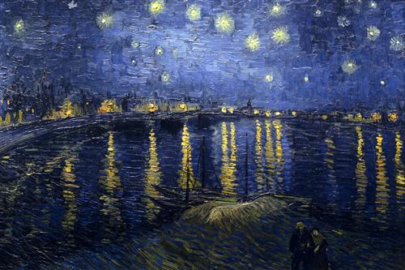
The Starry Night over the Rhone, 1888

Slide 23
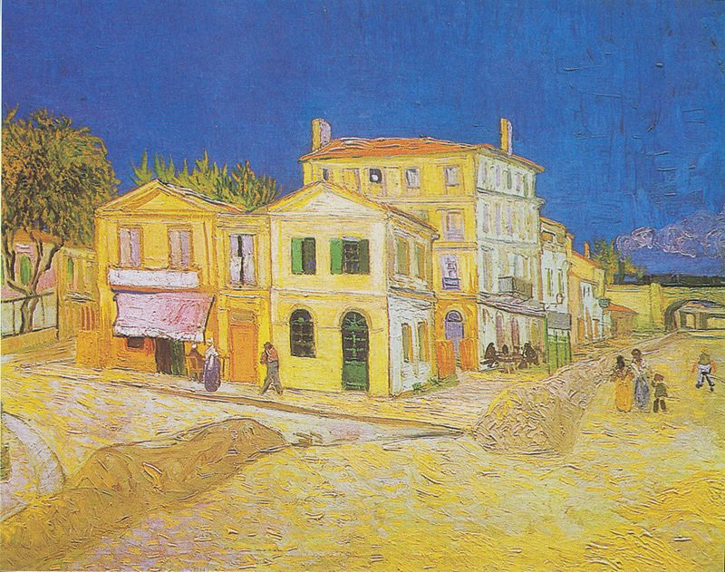
In 1888, Vincent moved to Arles, a town in southern France. His friend, artist Paul Gauguin, came to visit him there. They did not get along during this visit, as Vincent often acted irrationally, and so Gauguin went back to Paris.
The Yellow House, 1888

Slide 24
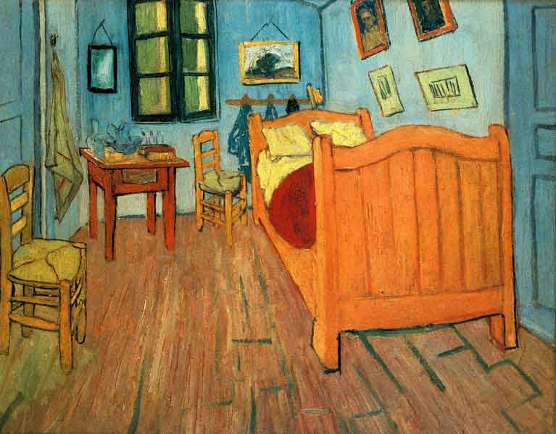
Bedroom in Arles, 1888

Slide 25
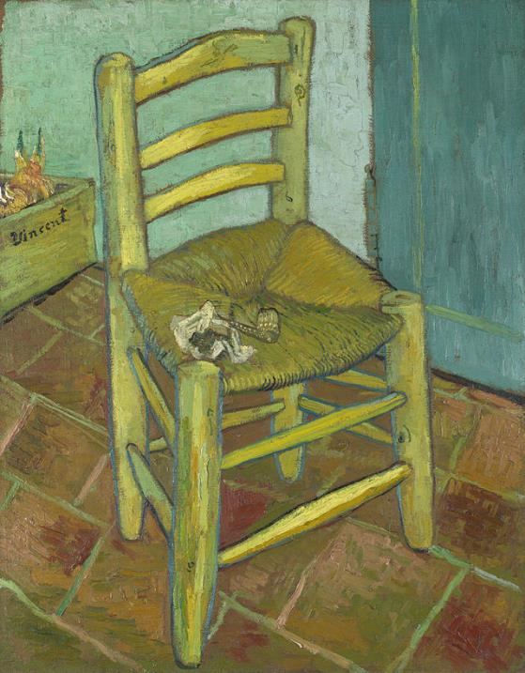
Van Gogh's Chair, 1888

Slide 26
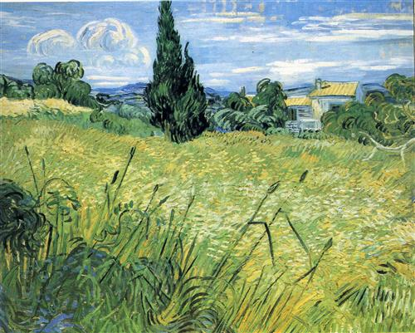
Vincent struggled with his
mental health for much of his life.
He committed himself to an asylum in Saint-Rémy in southern France to receive treatment. Here he created several paintings, many of which were of the property around the asylum. Here, he painted some of his most well-known paintings, including The Starry Night.
Green Wheat Field with Cypress
1889

Slide 27
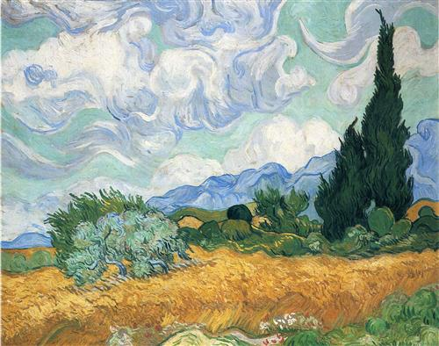
Wheatfield with cypress tree
1889

Slide 28

In Vincent van Gogh’s most widely recognized painting, The Starry Night, he portrays what is seen outside his window, along with memories and emotions he experiences when looking out.
The large white star to the right of the dark cypress tree is said to be Venus, which was visible from van Gogh’s window in the month he created the painting.
The village was fabricated from van Gogh’s memories and imagination.
The Starry Night,
June 1889

Slide 29
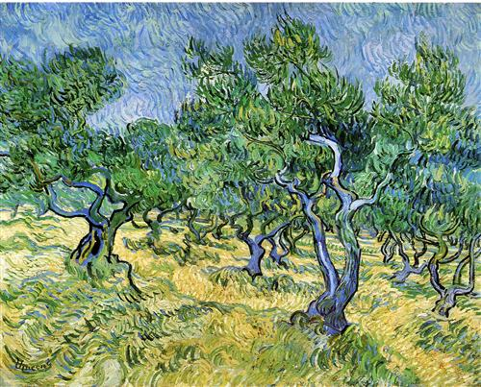
Olive Grove
1889

Slide 30
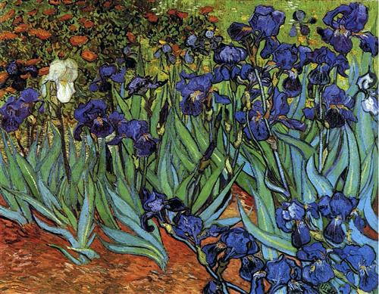
Irises
1889

Slide 31
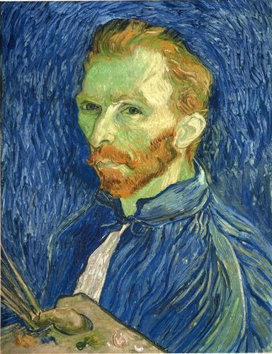
Self Portrait with Palette
1889

Slide 32
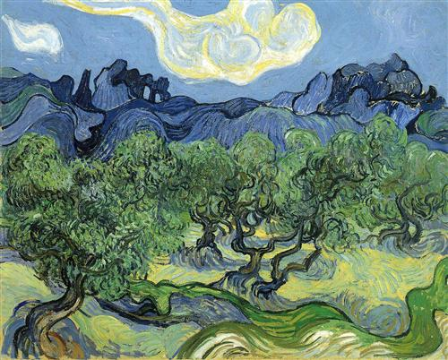
The Alpilles with Olive Trees in the Foreground
1889

Slide 33
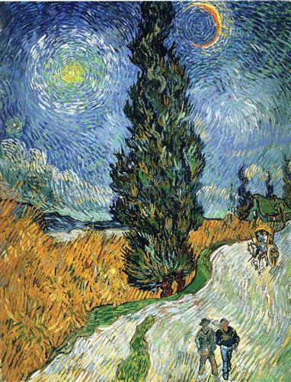
Road with Cypresses
1890

Slide 34
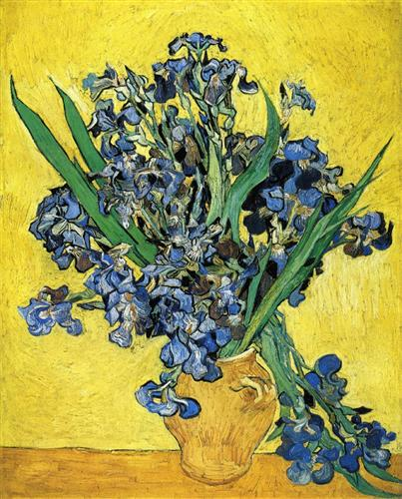
Still Life with Irises
1890

Slide 35
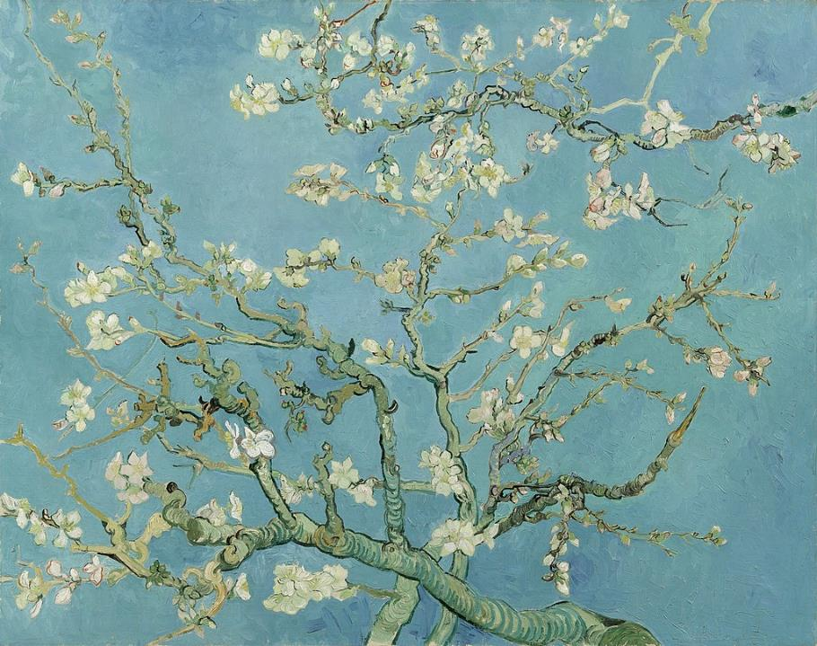
Almond Blossom
1890

Slide 36
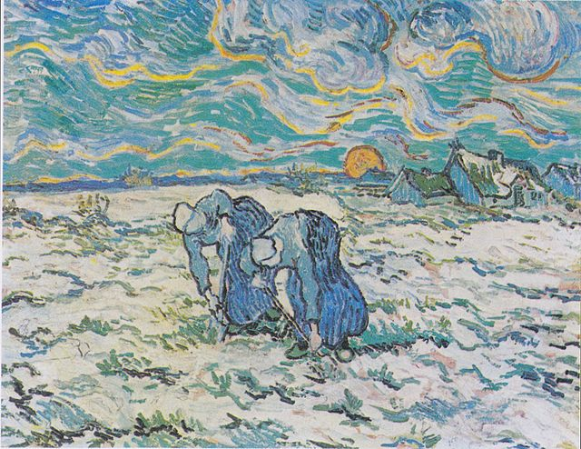
Two Peasant Women Digging in a Snow-Covered Field at Sunset, 1890

Slide 37
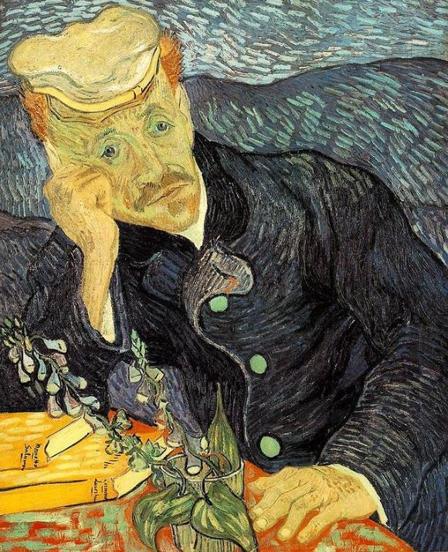
Portrait of Dr. Gachet, 1890

Slide 38
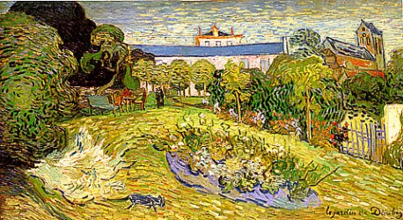
Vincent later moved north to be closer to his brother Theo again. Theo had always supported Vincent, and often financially helped Vincent when Vincent had trouble selling his paintings. Vincent died on July 29, 1890. Though Vincent experienced many misfortunes during his life, he left a legacy as an incredibly influential artist, who is still celebrated over a hundred years later.
Daubigny's Garden, July 1890

Slide 39
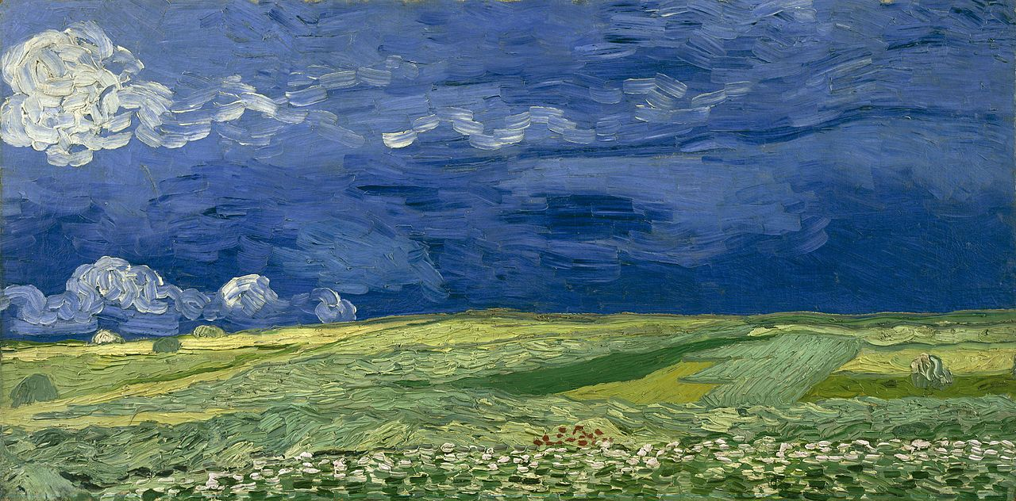
Wheatfield Under Thunderclouds, July 1890

Slide 40
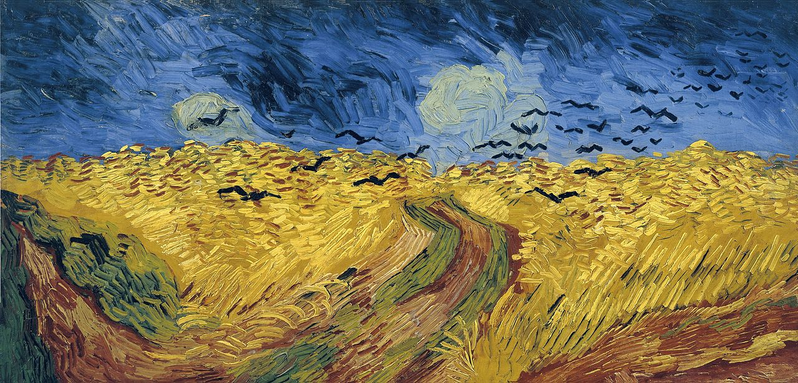
Wheatfield with Crows, July 1890

Slide 41






I hope you enjoyed using this PowerPoint to teach and learn about this artist. This PowerPoint was shared for personal or educational/classroom use only. It may not be copied, redistributed, or used for any other purpose.
Visit All About Art on TPT for PowerPoints about dozens of other great artists.
You can also find art lessons inspired by famous artists at www.allaboutarted.com.

